Slide 1
TITLE:SUPERSTORE PERFORMANCE ANALYSIS DASHBOARD
BY
AJETUNMOBI MARIAM

Slide 2
DATASET OVERVIEW
The superstore dataset contains sales transactions from a retail superstore.
It consists of approximately 10,000 records and 21 columns
The data includes customer, product, sales, profits, discount, shipping and regional information.
It supports analysis of business performance, profitability, and sales patterns.

Slide 3
BUSINESS PROBLEM
The retail company generate large amounts of sales data which needs to be properly analysed to monitor sales performance, profitability, and products trends to support data-driven decision making.
KEY BUSINESS QUESTIONS
Which region generate the highest sakes and profit?
Which product category perform best?
Which product are underperforming?
Which customer segment contributes the most sales and profit?

Slide 4
KEY PERFORMING INDICATORS(KPIs)
Total Sales: Measures the overall revenue generated from all transactions.
Total Profit: Shows the total earnings after deducting costs, indicating business profitability.
Total Orders: Represents the total number of customer transactions completed.
Profit Margin: Indicates the percentage of profit generated from sales, helping to assess efficiency and pricing strategy.
Average Discount: Measures the average discount applied across all sales, used to evaluate its impact on profitability.

Slide 5
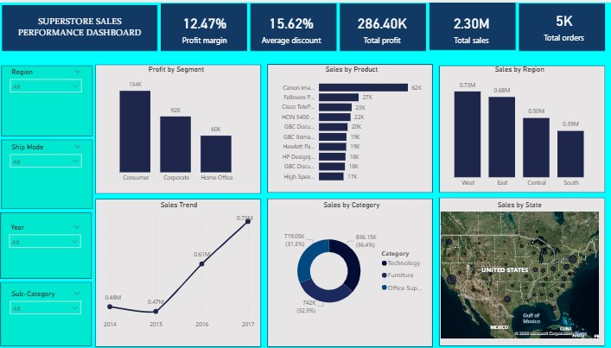
DASHBOARD

Slide 6
INSIGHTS
Segment Performance: The Consumer segment contributes the highest proportion of both sales and profit, making it the most valuable customer group for the business.
Product Performance: Certain products drive significantly higher sales than others
Category Analysis: The Technology category performs strongly in terms of sales, showing it is a key driver of revenue.
Regional Performance: Sales are not evenly distributed across states, with a few key states generating a large share of total revenue.
Sales Trend Over Time: Sales performance shows fluctuations across years, indicating changes in demand patterns and business cycles over time.

Slide 7
RECOMMENDATIONS
The discount strategy should be optimized to reduce the impact of excessive discounts on profitability
Marketing efforts should be focused on the consumer segment to maximize revenue and profit
Sales strategies should be strengthened in underperforming states to drive growth across more regions
Loss making products should be reviewed to improve overall profitability

Slide 8
CONCLUSION
The business is performing well in terms of sales volume and profitability. However, improving pricing efficiency, controlling discounts, and focusing on high-performing products and regions can further increase profitability and drive sustainable growth.
Notes:
s

